Slide 1
BA With R Project Predicting Cancellations of Hotel Bookings
Group Number 10
By:
Likith Vinayaka Giridhar (LXG210034)
Praful Patil (PVP220001)
Sai Rohit Boggarapu (SXB220120)
Rahul Kintali (RXK210144)

Slide 2

Business context:
Dataset provides a wealth of information on bookings made at a city hotel and a resort hotel
With data points including booking dates, length of stay, and party size, as well as details on parking availability
Data set has the potential to transform our understanding and analysis of hotel bookings, providing valuable insights for anyone interested in the hospitality industry.

Slide 3
Let us discuss our Dataset
The target variable is canceled which represents binary classes 0 and 1 where 0 is Not Cancelled and 1 is Cancelled
The remaining variables provide additional details about the booking, including lead time, arrival date, length of stay, number of guests, type of meal, country of origin, market segment, distribution channel, room type, deposit type, and more.
Some of the variables have numerical values, while others are categorical or binary.
The dataset layout provides a tabular format with rows representing individual bookings and columns representing attributes of the bookings.
The dataset could be useful for analyzing patterns in hotel bookings and predicting future bookings, as well as identifying factors that contribute to cancellations.

Slide 4
Explored Interesting Libraries:
Dplyr: Used for creating pipelines to build subsets of data frames and data frames summary.
Tidyr: Used in conjunction with dplyr to clean data.
Plotly: Used to create interactive plots (annotations)
FactoMineR: Exploratory data analysis methods to summarize, visualize and describe data.
Countrycode: Used for converting country names and codes from one format to another.
Lubridate: To manipulate date.
Mice: Used for imputing data.

Slide 5
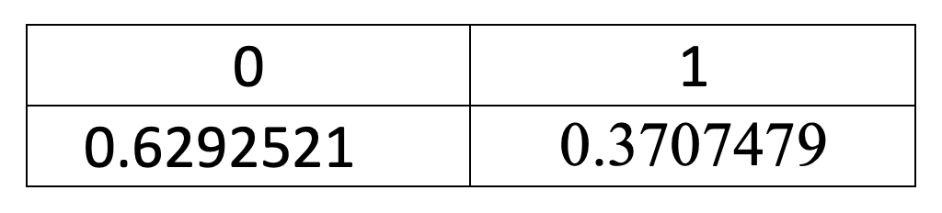
Challenges faced
1. Dataset imbalance: Our dataset has a slight class imbalance, which may affect the accuracy of our binary class statistics scores.
2. Missing values: The "Country" column has missing values, and we have excluded it from our analysis to ensure data integrity and accuracy.
3. Handling categorical variables: One-hot encoding and PCA for categorical data would increase the dimensionality of the dataset significantly, requiring high computational power and time, so we were unable to perform it.
4. Feature selection: High correlation with target variable: The "reservation_status" column, a categorical variable, has almost 100% correlation with our target variable, so we removed it from our analysis to avoid potential bias. Note that this anomaly is not reflected in the correlation heat map as it only considers numerical variables.

Slide 6
Data cleaning, manipulation and Data Pre-Processing for data visualization
Convert character columns to factors
Eliminate NA and other undefined values – Omit missing Records
Some rows contain entries with zero adults, children, and babies, so we deleted these records as they have Zero guests.
Meal column having “Undefined” values have been replaced by Mode value.
Records with “Undefined” values in “market_segment” and “distribution_channel” have been deleted.

Slide 7
Data cleaning, manipulation and Data Pre-Processing for building the model:
Plotting Heat Map to check for correlation in numeric data: We observe that none of the numeric variables are highly correlated to the target variable “is_canceled”
Based on Intuition, we remove some of the irrelevant columns such as “agent”, “company”, “reservation_status_date”
We also remove the categorical variable “reservation_status” because of 100% correlation with our target variable “is_canceled”
We replace missing values with the mode for categorical variables, we impute children=”0”, country=”Unknown”, meal=”SC”
We replace missing values of numeric variables with their median, for variables “lead_time” and “required_car_parking_spaces”

Slide 8
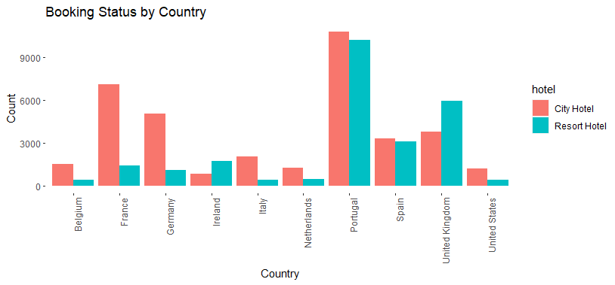
Where do the guests come from?
Subset the data to include the countries which has more than 1500 reservation request otherwise including all the country with few or occasional request to avoid the graph from being clumsy.The highest number of tourists are from Portugal.

Slide 9
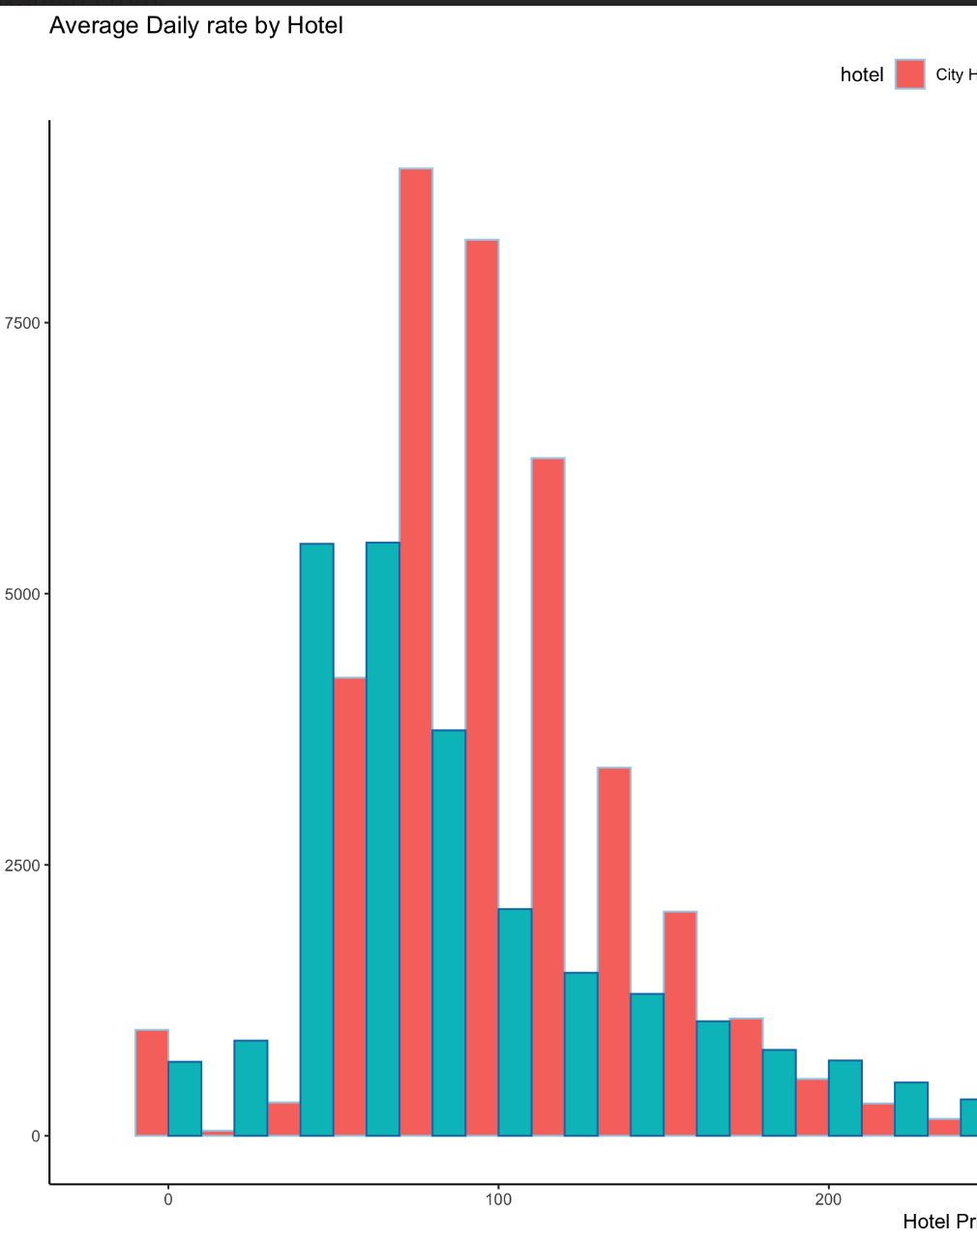
How much do guests pay for a room per night?
From the plot below we can examine that the rate for City hotels are higher that Resort hotels.
On an average a guest pays around 60-90 Euros per night.
we can see that the demand for the city hotel is higher compared to resort hotel, this will account to higher price per room per night.

Slide 10
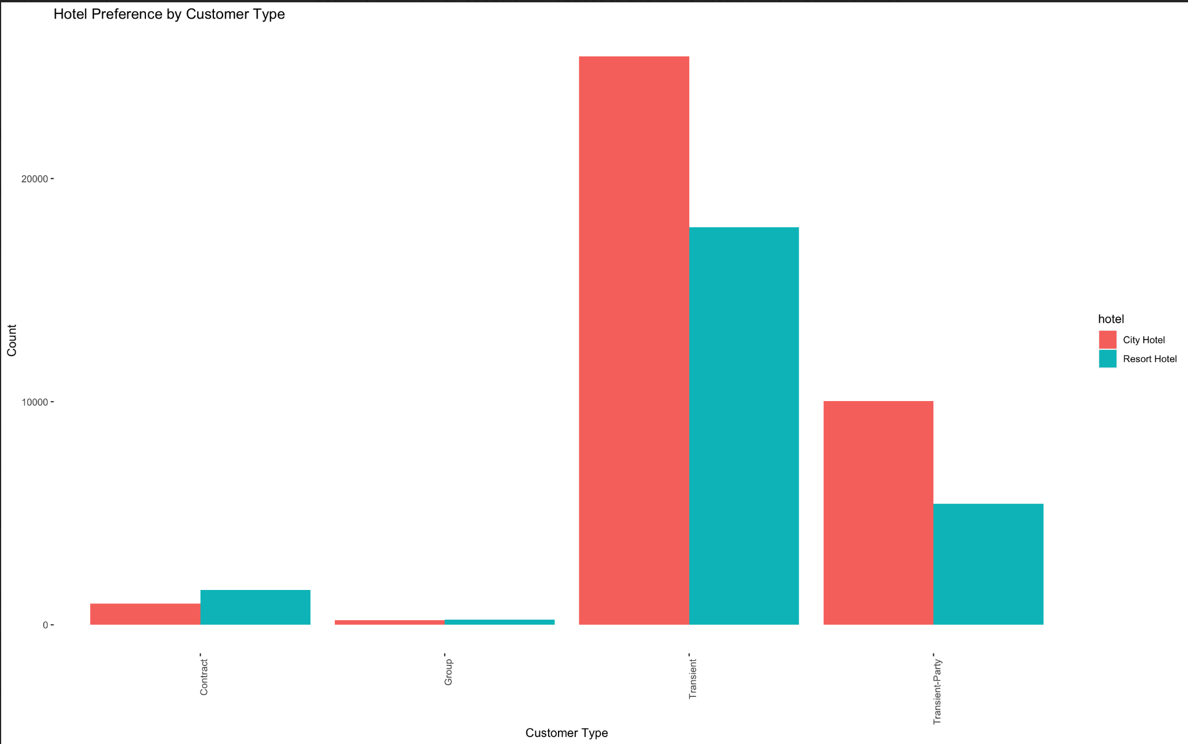
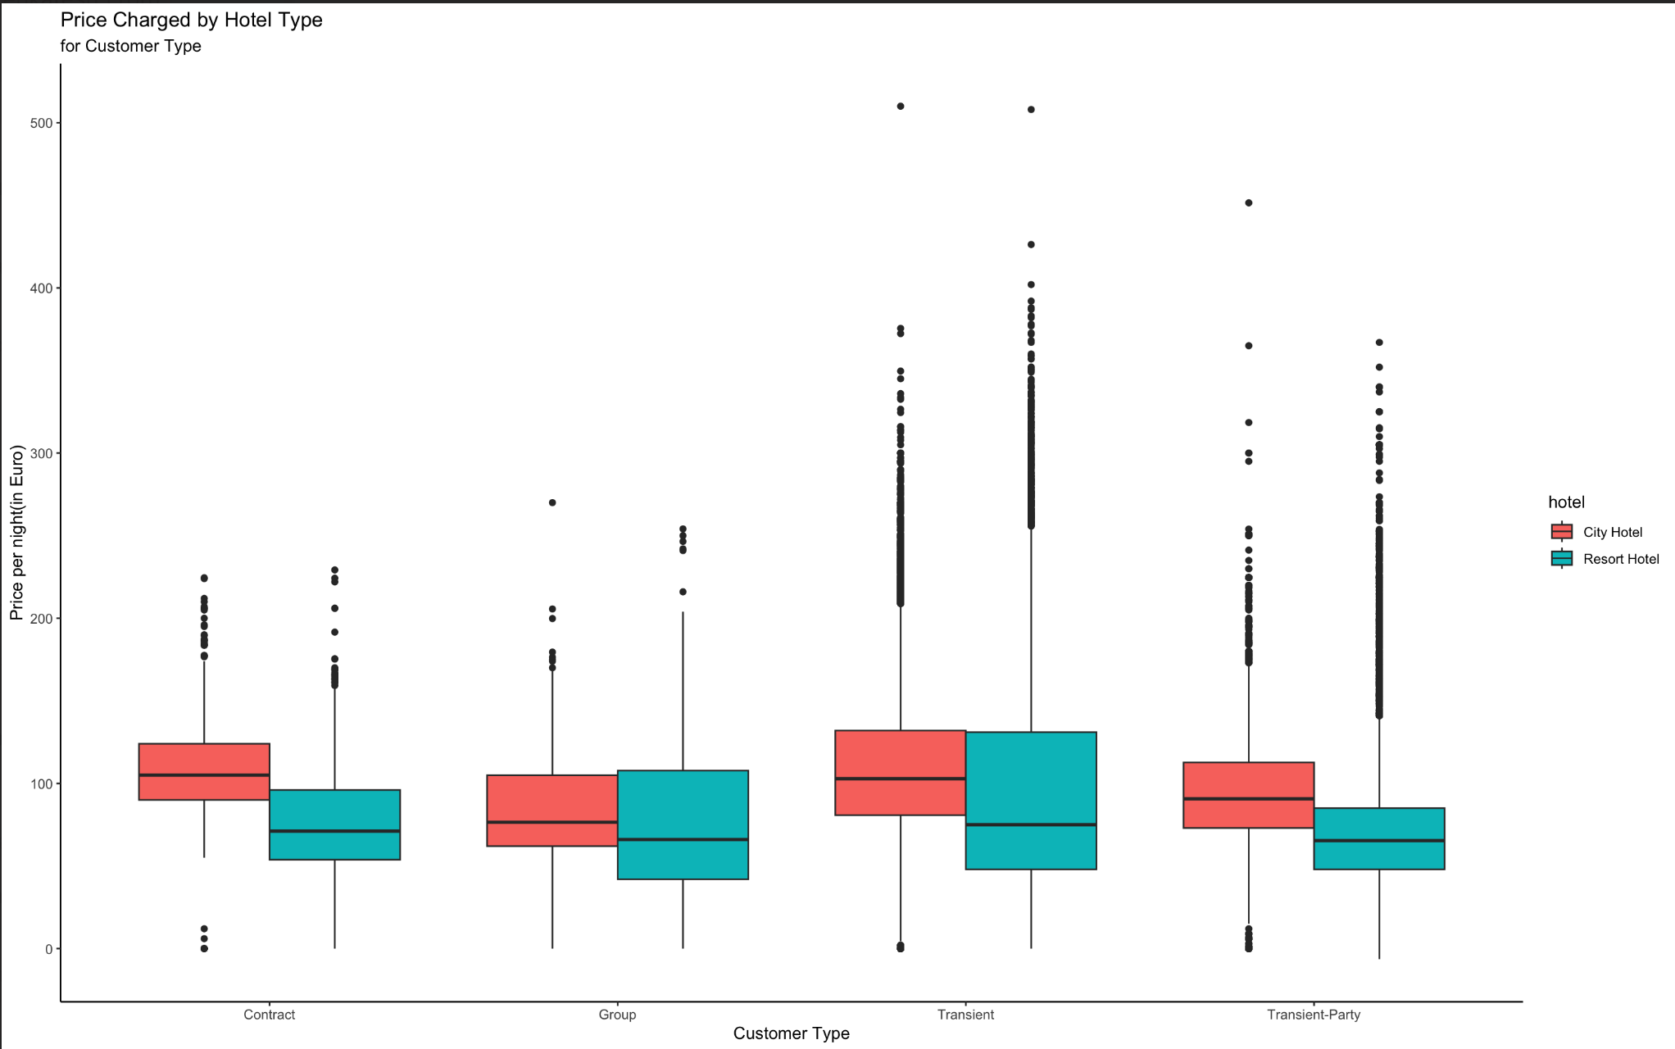
How much do guests pay for a room per night?
The highest number of guests are from transient customer type bookings and lowest being for group customer type bookings. This trend can be seen for both the hotel types.
Prices charged by both the hotel types for different customer types remains more or less the same.
The spread of outliers is extremely large for Transient and Transient-Party

Slide 11
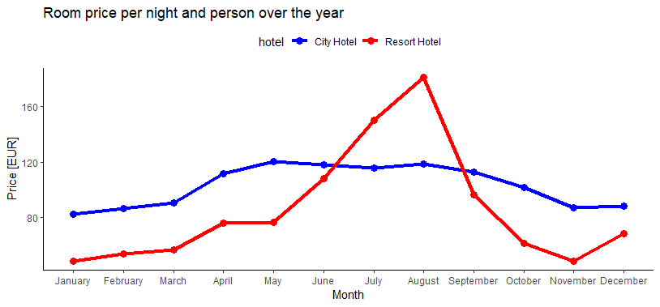
How does the price per night vary over the year?
We can notice that this is a peak and valley plot. The price per night is maximum in August and Minimum in January and November for resort hotel. For Resort hotel the price hikes from May to August and drops till November.

Slide 12
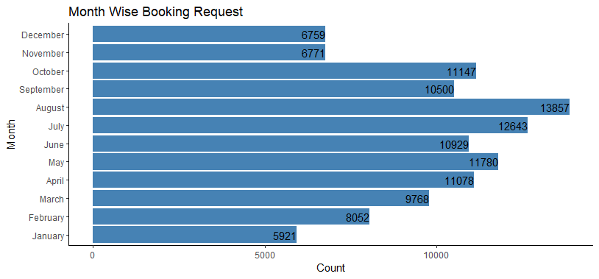
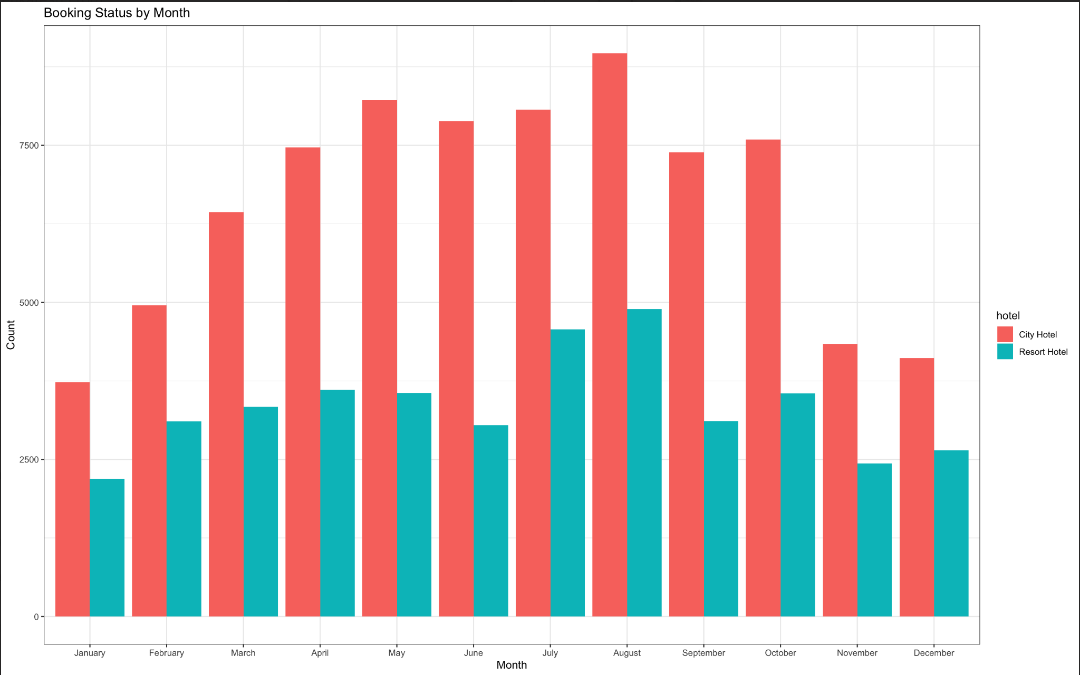
Which are the Busiest Month?
For city hotel we can see the bookings consistently remain around 7500 or more from April to October and the bookings drop in winter months. This trend is very similar in resort hotels but the bookings hover around half of city hotels

Slide 13
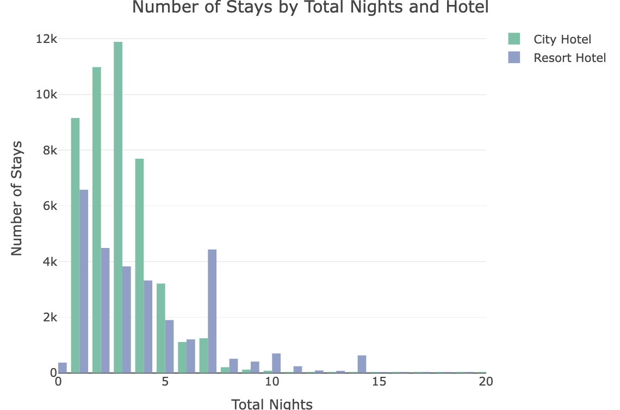
How long do people stay at the hotels?
We can notice that most of the people stay for around 3 nights at a hotel and maximum people stay on an average of between 0-5 days. Also, the trend is similar in for both the hotels

Slide 14
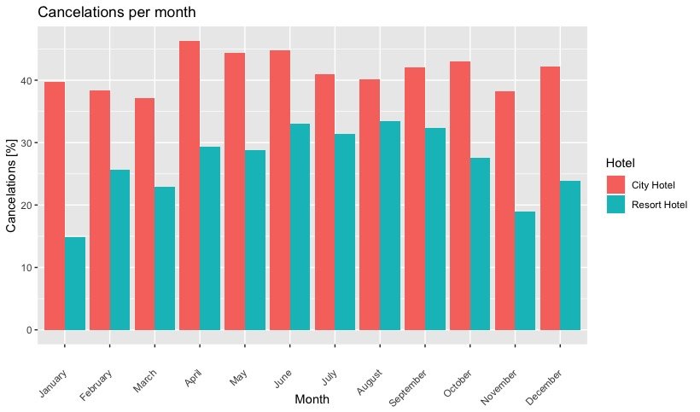
How many bookings were cancelled?
There were 37% of total bookings cancelled and in that City Hotel has more cancellations.
Total bookings canceled: 44,195 (37%)
Resort hotel bookings canceled: 11,120 (28%)
City hotel bookings canceled: 33,075 (42%)
Which month have the highest number of cancelations?
Looking at the plot below we can notice that although the cancellations for city hotel is highest in April and for resort hotel it is in August. We have taken percentages as it gives a normalized

Slide 15
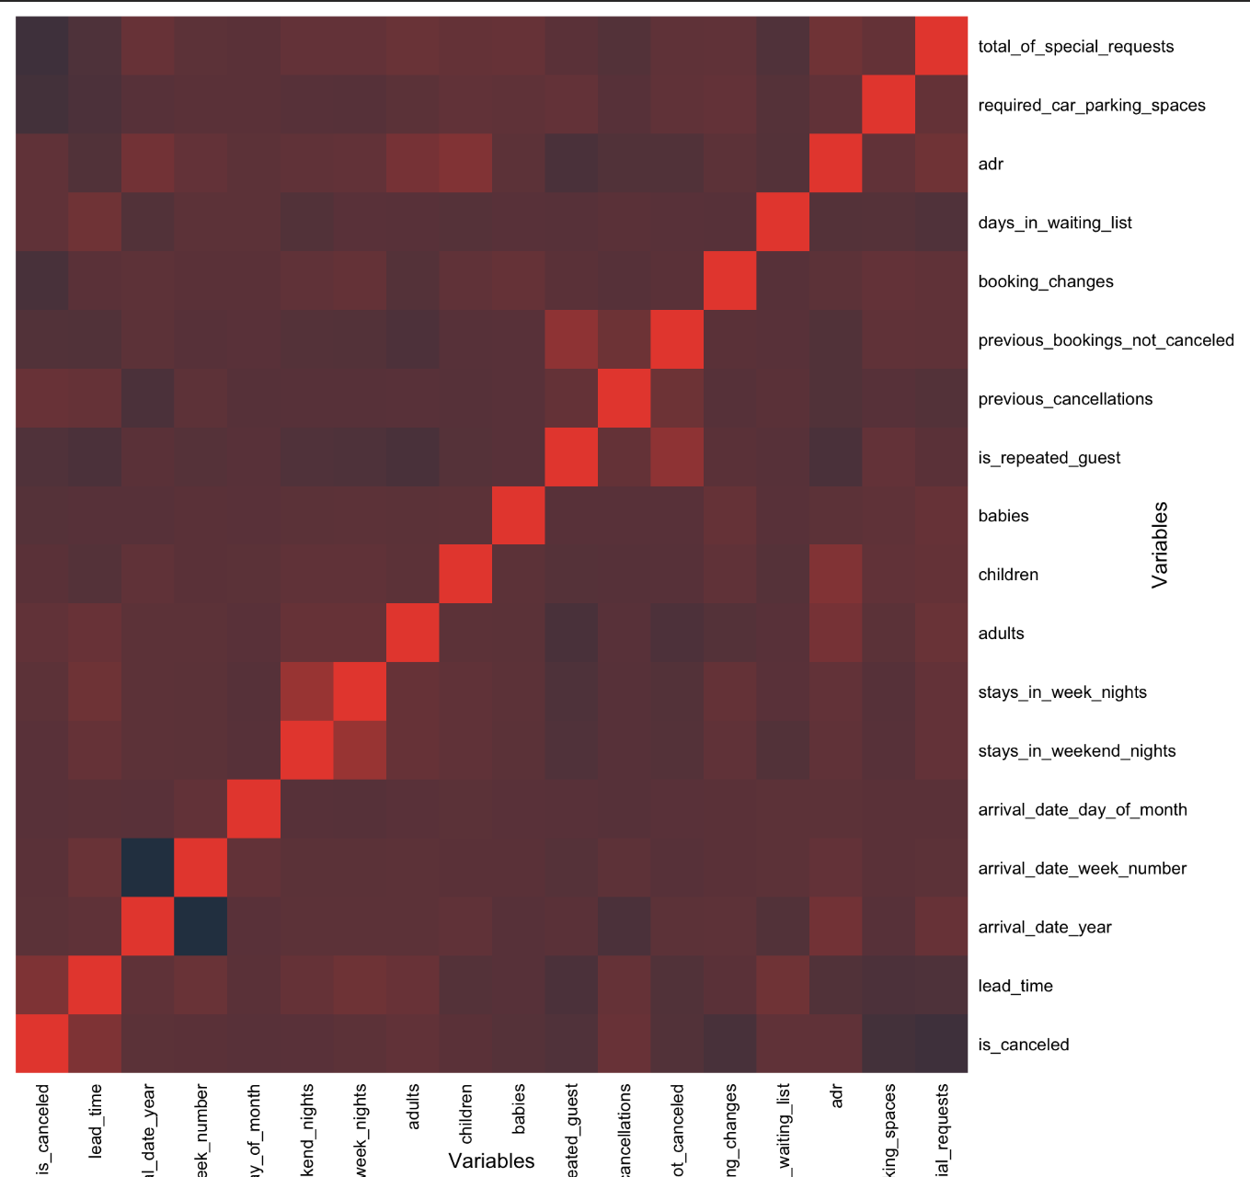
Data Preprocessing and Cleaning in preparation for modeling
Correlation Heat map

Slide 16
Feature Engineering:
We combine arrival_date_year, arrival_date_month, arrival_date_day_of_month to form a new variable called arrival_date
Create a new variable called total_guests by adding the number of adults, children, and babies.
Then we convert the categorical variables to factors
Principal Component Analysis:
We perform Principal Component Analysis on numeric variables.
We merge the PCA values with the categorical variables.
We use the first 3 components which capture majority of the data

Slide 17
Logistic Regression Model
Logistic Regression Model
In the random forest approach, many decision trees are created. Every observation is fed into every decision tree. The most common outcome for each observation is used as the final output. A new observation is fed into all the trees and taking a majority vote for each classification model.
Accuracy: 0.8378
AUC: 0.80469
Sensitivity: 0.6750
F1_score: 0.75530
Regression analysis is a very widely used statistical tool to establish a relationship model between two variables.
Accuracy: 0.7894
AUC: 0.7348
Sensitivity: 0.9460
F1_score: 0.6483

Slide 18
Future Work
Based on the above metrics, the Random Forest model appears to be the better choice for the hotel booking cancellation prediction problem, as it has higher accuracy, Kappa score, specificity, positive predictive value, negative predictive value, F1 score, and AUC compared to the Logistic Regression model.
However, it's important to consider other factors such as model interpretability, computational resources, and specific business requirements before making a final decision.
Future Work
Performing oversampling or under sampling on the target variable and re-running the models to analyse performance.
Check the dependence of target variable on each level of each of the categorical variables. Then select the necessary categories and one hot encode. Finally perform PCA on the one hot encoded categorical sub data frame

